Slide 1
生物医学信号处理综合实验
吉翔 白景峰
xiangji@sjtu.edu.cn

Slide 2
Lecutre 2

Slide 3
Codes & Report
File folder named as 'Project X'
  Sub file folder named as 'src'
    Store source codes
  Sub file folder named as 'release'
    Store executable file
  Report (doc/PDF-formatted)
  Other files

Slide 4
Review (Project 1)
Find device
Read data
  Instant AI
  Buffered AI
Plot data
Save data
Timer

Slide 5
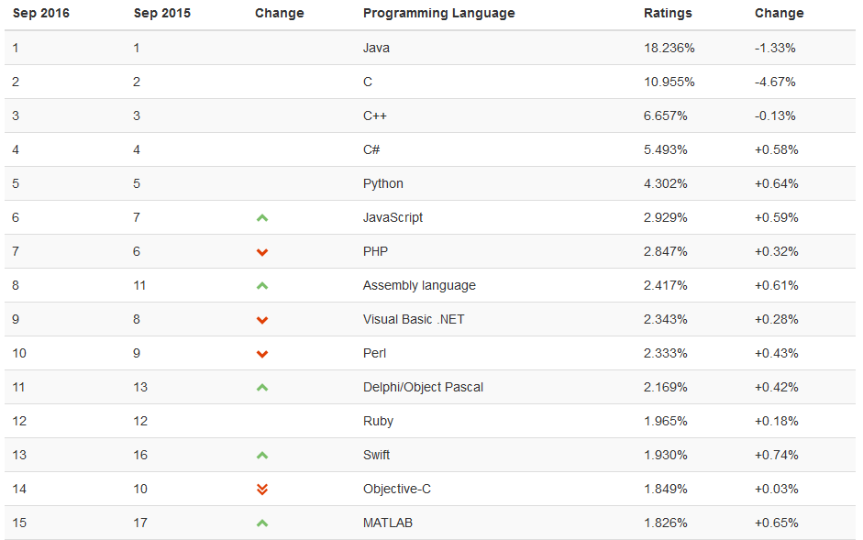
TIOBE Index
http://www.tiobe.com/tiobe-index/

Slide 6
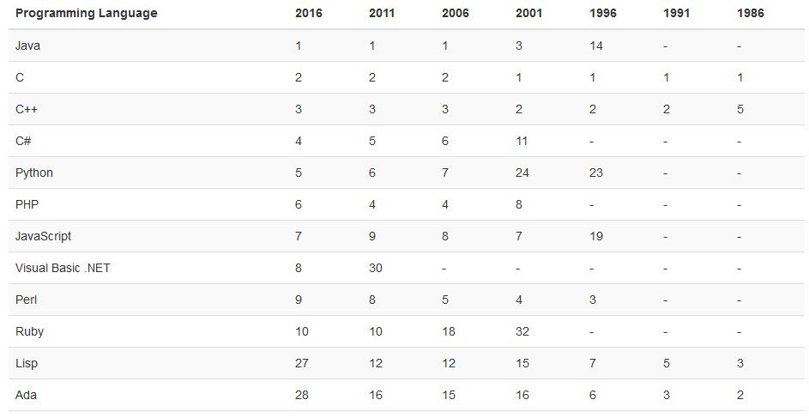
TIOBE Index
http://www.tiobe.com/tiobe-index/

Slide 7
Analog Onput
Application
  Signal Generator
  Microcontrollers
    Analog Output
  Digital-To-Analog Converter
    Wiki

Slide 8
Project 2
Generate waveform
  Load file
  Edit waveform
Display output waveform
Output waveform
  Change frequency
  Change points per period

Slide 9
Project 2
Output control
  Start
  Pause/Resume
  Fixed points
  Infinite points

Slide 10
Tools
USB-4704
Analog Discovery
DAQNavi SDK

Slide 11
Recruit
Graduate Projects
  Power Meter for Ultrasound Driving System
    Supervised by ZHANG Su & JI Xiang
    Develop prototype
    PCB test and debug
    Calibration

